Slide 1
Handling Errors in Python
try / except — write code that survives the unexpected, instead of crashing on it.

Slide 2
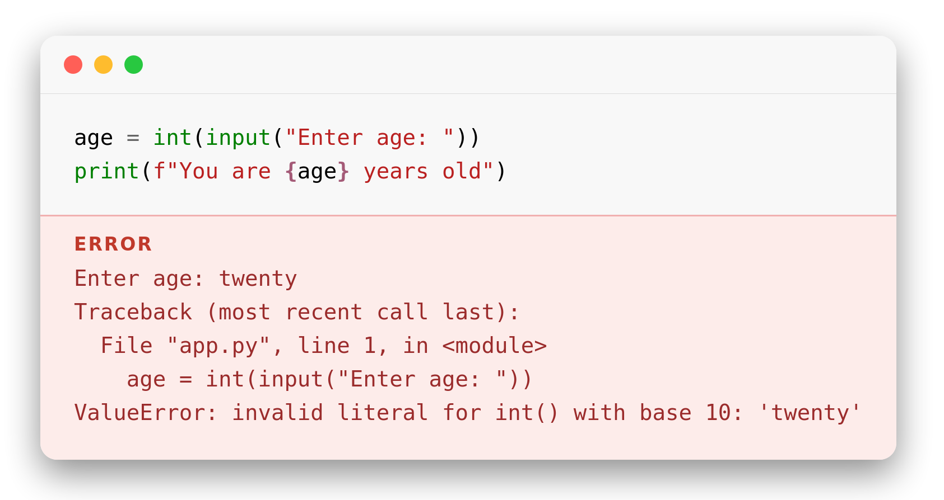
Why Exception Handling?
The problem
Bad input, missing files, network hiccups — things go wrong at runtime.
An unhandled exception stops the program immediately, wherever it happens.
We want to anticipate failure and recover gracefully instead of crashing.
● Note: an uncaught exception halts the whole program instantly — nothing after it runs.
Notes:
age = int(input("Enter age: "))
print(f"You are {age} years old")

Slide 3
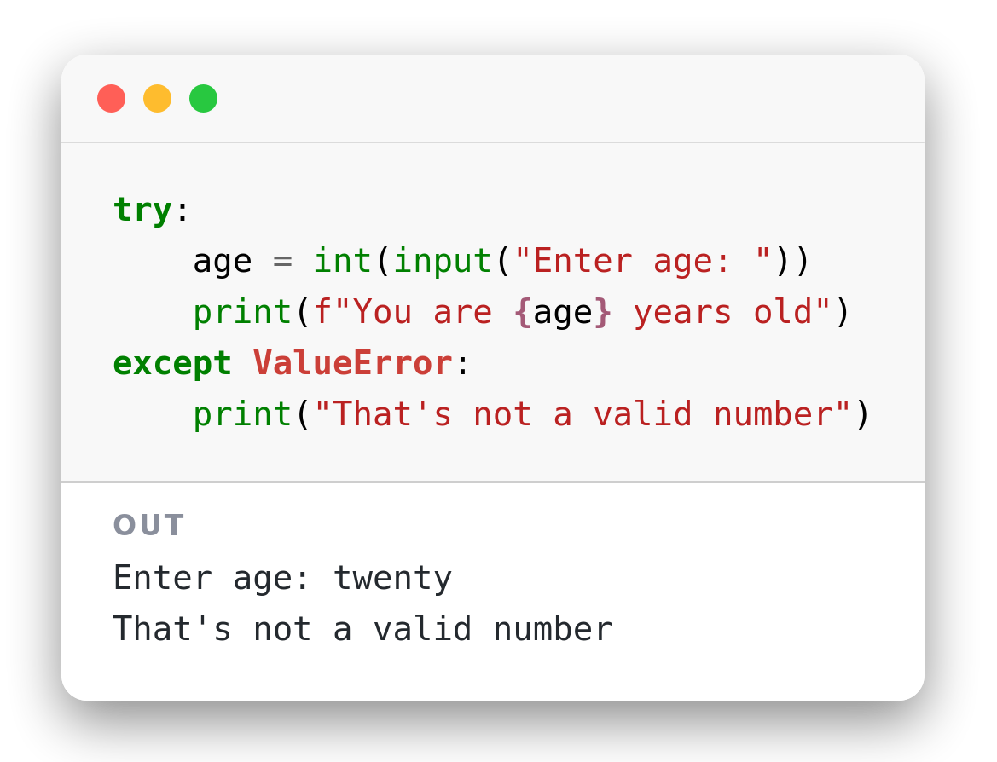
Basic try / except Syntax
How it's written
Code that might fail goes inside the try block.
If an exception occurs, control jumps to the matching except block.
The program keeps running afterward instead of crashing.
Notes:
try:
age = int(input("Enter age: "))
print(f"You are {age} years old")
except ValueError:
print("That's not a valid number")

Slide 4
How It Flows
Try block
runs normally
Exception
occurs
Python finds a
matching except
Except runs,
program continues
If no exception occurs, every except block is skipped entirely.
Only the first matching except runs — Python stops looking after that.
Code after the whole try/except block always continues, either way.

Slide 5
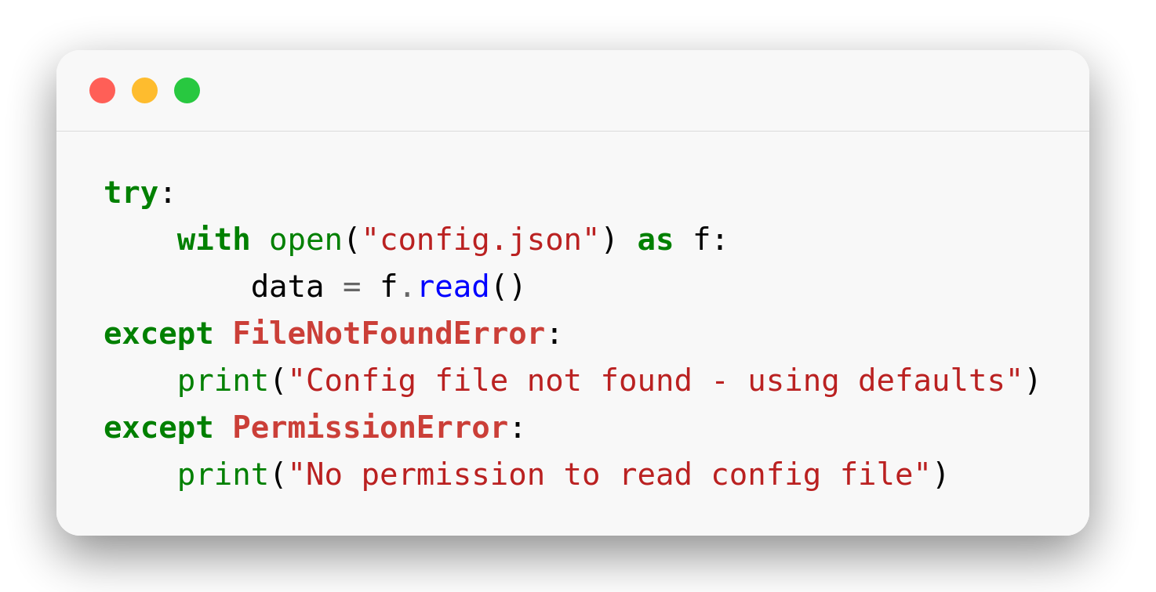
Catching Specific Exceptions
Name the exception
Catch only the exception type you expect — never a bare `except:`.
Different problems get different except blocks, each with its own fix.
Unexpected errors still crash loudly instead of being hidden by accident.
● Caution: avoid bare except: — it silently catches everything, including typos, making bugs hard to find.
Notes:
try:
with open("config.json") as f:
data = f.read()
except FileNotFoundError:
print("Config file not found - using defaults")
except PermissionError:
print("No permission to read config file")

Slide 6
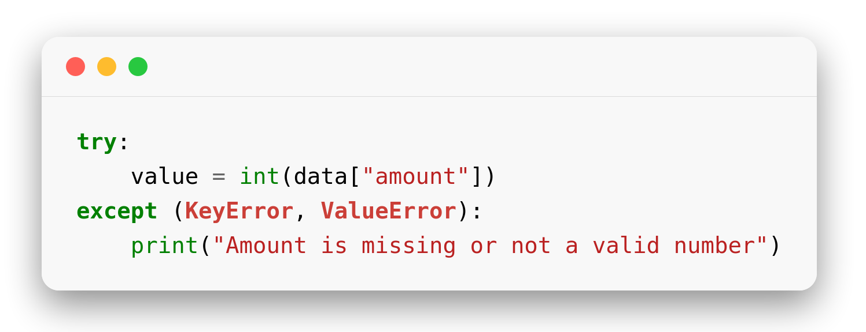
Catching Multiple Exceptions
One block, several types
Group related exception types in a tuple: except (KeyError, ValueError):
Use this when the same fix applies to more than one failure mode.
Keep unrelated exceptions in separate except blocks with their own handling.
Notes:
try:
value = int(data["amount"])
except (KeyError, ValueError):
print("Amount is missing or not a valid number")

Slide 7
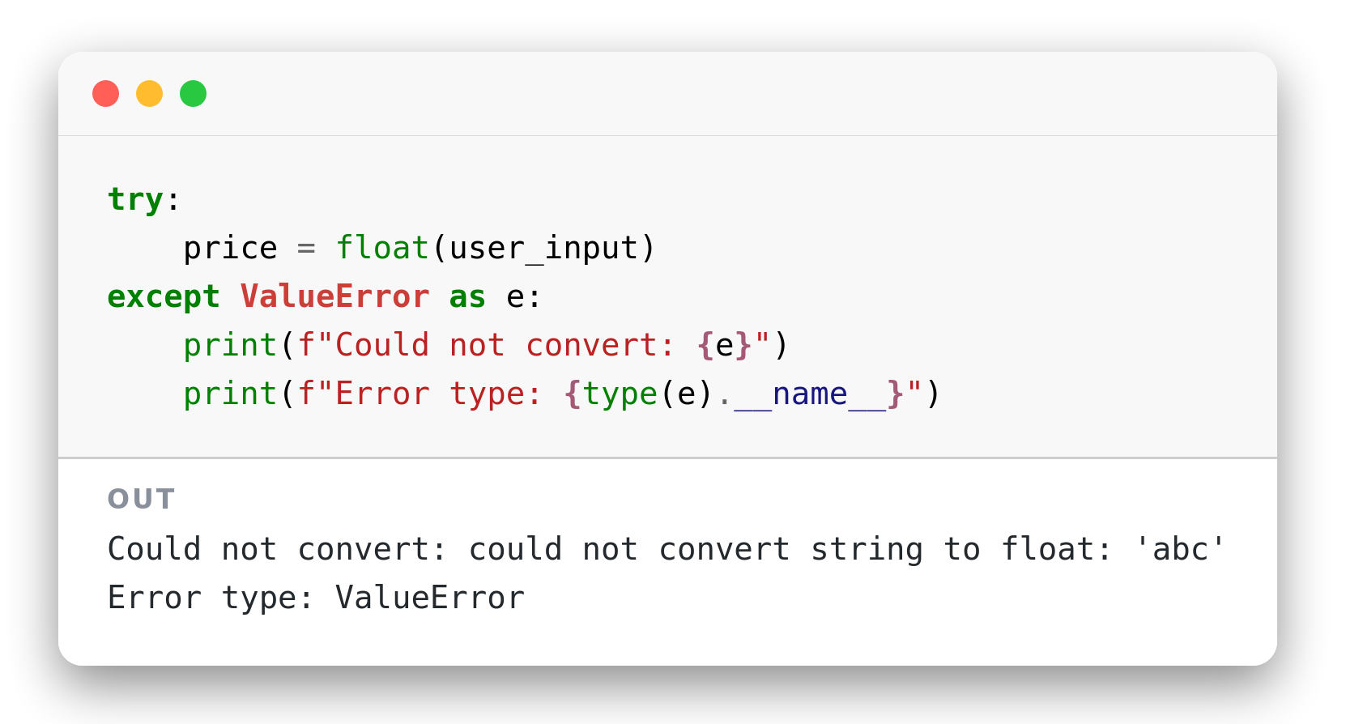
The Exception Object
Reading the error
except ValueError as e: captures the exception into a variable.
str(e) gives the error message Python generated for that exception.
type(e).__name__ tells you the exact exception class that was raised.
Notes:
try:
price = float(user_input)
except ValueError as e:
print(f"Could not convert: {e}")
print(f"Error type: {type(e).__name__}")

Slide 8
Exercise

Slide 9
Digits & Length
1
Numbers only
2
Fixed length input
Ask the user to input a phone number
If it is not a number, print an error and ask again
Stop only when the input converts with int()
Ask the user to input a phone number (once, no loop)
If it is a number, check len() is 9 or 10
Print OK, "Need 9-10 digits", or the error
is_not_number = True
while is_not_number:
raw = input("Enter phone number: ")
try:
# TODO: int(raw) -> print OK, stop loop
except ValueError:
# TODO: print "Digits only, please"
raw = input("Enter phone number: ")
try:
# TODO: convert raw with int()
# TODO: if len is 9 or 10 -> print "OK"
# else print "Need 9-10 digits"
except ValueError:
# TODO: print "Digits only, please"
Expected output:
Expected output:
abc → Digits only, please. (ask again)
012345678 → OK
0123 → Need 9-10 digits.
0123456789 → OK
Notes:
ANSWER - Exercise 1 (Numbers only):
is_not_number = True
while is_not_number:
raw = input("Enter phone number: ")
try:
number = int(raw)
print("OK")
is_not_number = False
except ValueError:
print("Digits only, please.")
ANSWER - Exercise 2 (Fixed length input):
raw = input("Enter phone number: ")
try:
number = int(raw)
if len(raw) == 9 or len(raw) == 10:
print("OK")
else:
print("Need 9-10 digits.")
except ValueError:
print("Digits only, please.")

Slide 10
Carrier & Bulk Check
3
Phone carrier prefix
4
Check many numbers
Use the carrier dict: each name holds a list of prefixes
Ask the user to input a phone number
Search for number[0:3] — if no name has it, catch KeyError
Ask the user to input how many numbers to check
Then ask the user to input that many phone numbers
If the count is not a number, print an error
carrier = {"smart": ["010","070","016"],
"cellcard": ["011","012","092"]}
try:
# TODO: input a phone number
# TODO: print the name that owns number[0:3]
except KeyError:
# TODO: print "Unknown carrier"
try:
# TODO: input "How many numbers? "
# TODO: convert the answer with int()
# TODO: repeat that many times:
# input "Phone: " and print it
except ValueError:
# TODO: print "Please type a number"
Expected output:
Expected output:
0921234567 → cellcard
0161234567 → smart
0991234567 → Unknown carrier
How many numbers? two → Please type a number
How many numbers? 2 → asks Phone: twice
Notes:
ANSWER - Exercise 3 (Phone carrier prefix):
carrier = {"smart": ["010","070","016"], "cellcard": ["011","012","092"]}
prefix_to_name = {}
for name, prefixes in carrier.items():
for p in prefixes:
prefix_to_name[p] = name
number = input("Enter phone number: ")
try:
print(prefix_to_name[number[0:3]])
except KeyError:
print("Unknown carrier")
ANSWER - Exercise 4 (Check many numbers):
try:
count = int(input("How many numbers? "))
for i in range(count):
raw = input("Phone: ")
print(raw)
except ValueError:
print("Please type a number")

